Slide 1
Gradient Descent Algorithms
An analysis of the Gradient Descent Algorithms - Final Project
Assiya Karatay, Ayomide Awojobi & Ruiqi Chang
BU MET College, Computer Science Department
Spring 2022
CS 566 - Professor Alexander Belyaev

Slide 2
Agenda
Introduction
The different types of Gradient Descent algorithms
Stochastic Gradient Descent
Mini Batch Gradient Descent
Batch Gradient Descent
Pros and cons
Code implementation
Conclusion

Slide 3
Abstract
Gradient descent is an easy to understand and implement popular optimization strategy used in machine learning and deep learning.
Gradient descent is used in machine learning to find the values of a function’s parameters which are basically the coefficients that minimize a cost function as far as possible.
The goal of the project is review and analysis of the different types of this algorithm such as Stochastic, Batch, and Mini-Batch.

Slide 4
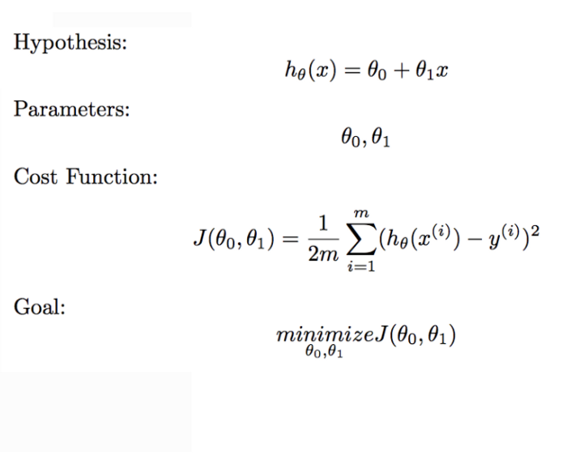
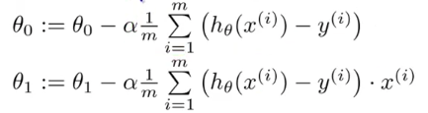
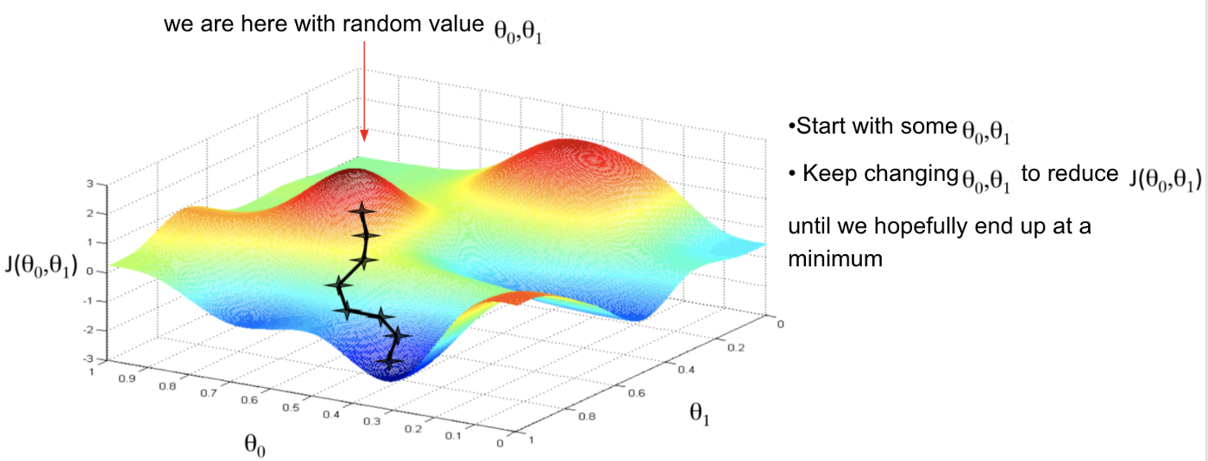
Gradient Descent
The derivative of cost function(slope or direction):

Slide 5
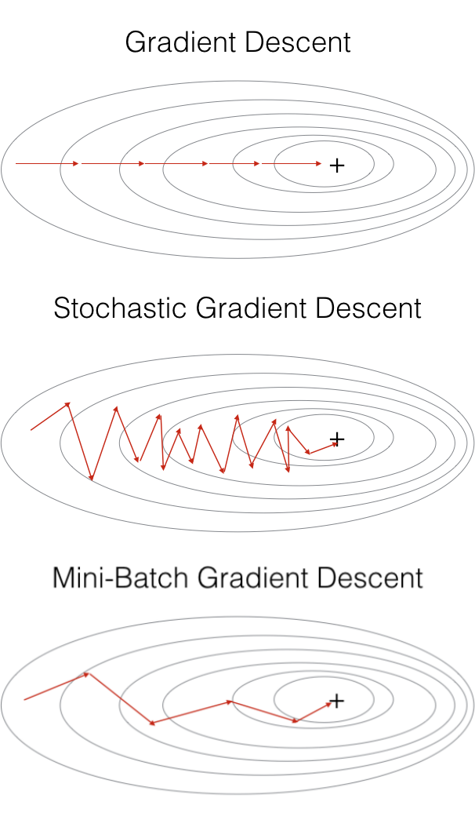
Batch Gradient Descent
# Iterate Loop, for each training sample, compute the gradient (d/d_theta j(theta))
grad0 = 1.0/m * sum([(t0 + t1*x[i] - y[i]) for i in range(m)])
grad1 = 1.0/m * sum([(t0 + t1*x[i] - y[i])*x[i] for i in range(m)])
# update the theta
t0 = t0 - alpha * grad0
t1 = t1 - alpha * grad1
# mean squared error
e = sum( [ (t0 + t1*x[i] - y[i])**2 for i in range(m)] )
Converged,
if abs(J-e) <= ep:
Batch Gradient Descent is a basic type of gradient descent which processes all the training examples for each iteration of gradient descent.
alpha = 0.01 #learning rate, ep = 0.01 # convergence criteria
def gradient_descent(alpha, x, y, ep, max_iter=10000):
m = number of samples
# initial theta: t0, t1
# total error, J(theta) for check if current parameter converged
J = sum([(t0 + t1*x[i] - y[i])**2 for i in range(m)])
Notes:
The primary set-up for learning neural networks is to define a cost function (also known as a loss function) that measures how well the network predicts outputs on the test set. The goal is to then find a set of weights and biases that minimizes the cost. One common function that is often used is the mean squared error, which measures the difference between the actual value of y and the estimated value of y (the prediction). The equation of the below regression line is hθ(x) = θ + θ1x, which has only two parameters: weight (θ1)and bias (θ0).

Slide 6
Batch Gradient Descent
Pros | Cons
More stable convergence and error gradient than stochastic gradient descent | Slower learning since an update is performed only after we go through all observations
Embraces the benefits of vectorization | Some examples may be redundant and don’t contribute much to the update.
A more direct path is taken to the minimum

Slide 7
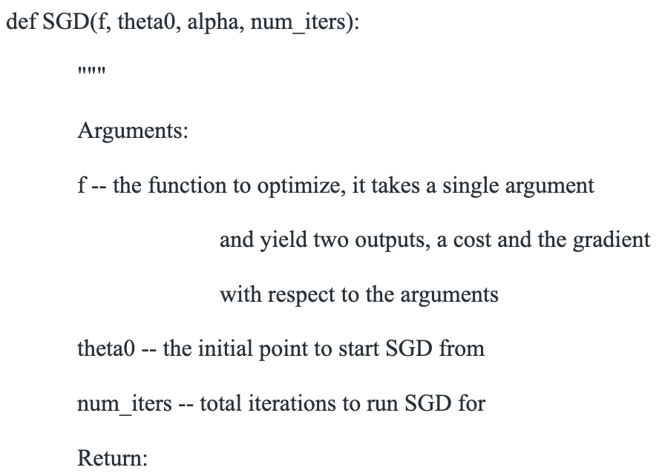
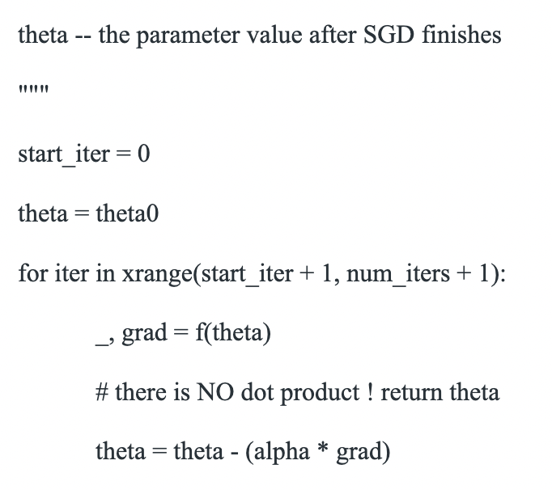
Stochastic Gradient Descent
This is an iterative strategy that searches through a large infinite hypothesis space whenever there are hypotheses continuously being parametrized and the errors are differentiable based on the parameters.

Slide 8
Pros and Cons of Stochastic Gradient Descent
Pros | Cons
Easier to fit into memory | Can veer of in wrong direction due to frequent updates
Computationally fast as only one sample is being processed at a time | Takes longer to achieve convergence to the minima of the loss function
For larger datasets, it can converge faster as it causes updates to the parameters more frequently | Frequent updates are computationally expensive

Slide 9

Mini-Batch Gradient Descent
Mini-Batch GD updates parameters after calculating the gradient of error with respect to a subset called mini-batch. This type of GD algorithm is more flexible and robust than other two types because of the fast convergence and the noise of the gradient update. (Khosla, 2019)
def miniBatchGradientDescent(X, y, learning_rate = 0.001, batch_size = 32):
theta = np.zeros((X.shape[1], 1))
error_list = []
max_iters = 3
for itr in range(max_iters):
mini_batches = create_mini_batches(X, y, batch_size)
for mini_batch in mini_batches:
X_mini, y_mini = mini_batch
theta = theta - learning_rate * gradient(X_mini, y_mini, theta)
error_list.append(cost(X_mini, y_mini, theta))
return theta, error_list

Slide 10
Pros and Cons of Mini-Batch Gradient Descent
Pros | Cons
Quick updates of parameters provides fast learning | We have to configure the mini-batch size hyperparameter
Vectorizing the code makes it computationally efficient
Based on the batch size, the updates can be less noisy and convergence is more stable comparatively to SGD

Slide 11
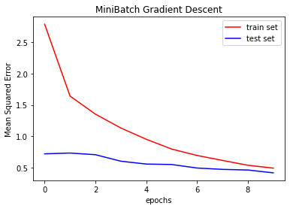
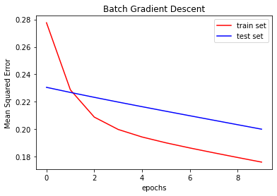
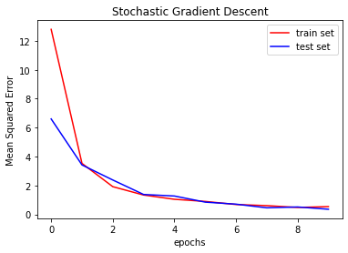
Code implementation results
Code can be found there: https://github.com/divassya/analysis_of_gradient_descent.git

Slide 12
Conclusion
Terminology:
Cost Function
Learning Rate
Three Gradient Descent Algorithm
Batch Gradient Descent
Mini-Batch Gradient Descent
Stochastic Gradient Descent
Code implementation

